Slide 1

A Project Report On “ANALYSIS, DESIGN AND IMLPEMENTATION OF CPU PROCESS RECORD MANAGEMENT SYTEM”
By
Gautam Kumar
Enrollment Number – A35705219026
Batch - 2019-2023
Semester – 5th
Submitted to
Mr. Biresh Kumar

Slide 2
Introduction
to better understand how you interact with technology
recognizing the potential damage that excessive use of screens can cause
whether it's reducing our attention time or hurting our productivity.

Slide 3
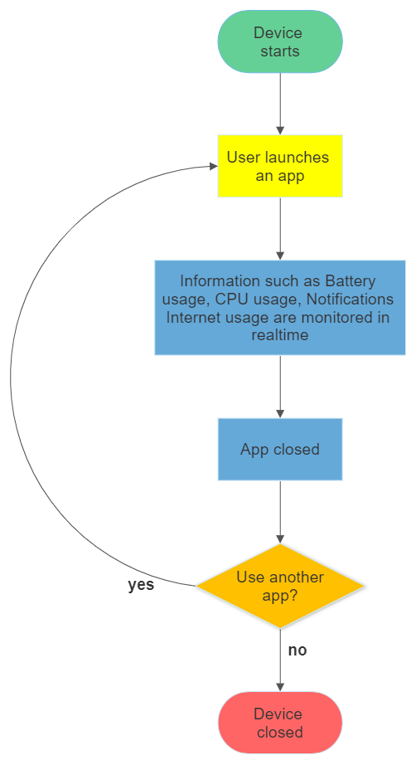
Flow chart

Slide 4
Scenario
In a modern-day multiprocessing computer of a modern-day student who has to use his desktop for various activities including Microsoft teams app, google chrome, Whatsapp, sticky notes and various others further in apps like google chrome the student visits various websites to access daily need content or study material and beyond. All this processes data can be captured when he uses it, and if there is a habit of the user like wasting some hours of his daily time in unnecessary activities like video games or YouTube or maybe others then either he by himself or his parents may use that data to keep in check that those habits can be minimized such that daily productivity of the student can be improved.

Slide 5
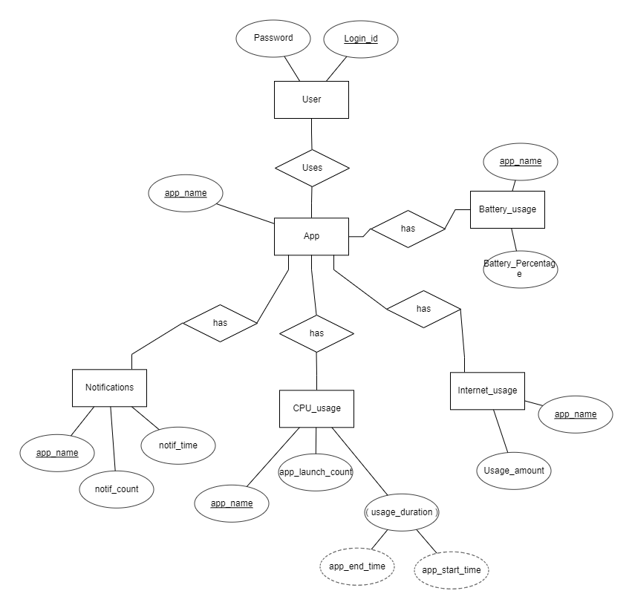
ER diagram

Slide 6
Entities
User: This will contain information of users of device.
App: This will contain information of apps available in device.
Battery usage: This will contain information of battery used by the device.
Internet_usage: This will contain information of internet used by the device.
CPU_usage: This will contain information of apps used by the user at any instance of time.
Notifications: This will contain information of notifications generated by apps of the device.

Slide 7
Relationship
Uses: Shows relationship between User and App.
has: Shows relationship of App with Notifications, CPU_usage, Internet_usage and Battery_usage.

Slide 8
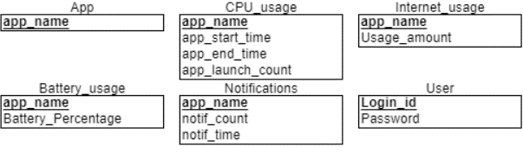
Relational Schema

Slide 9
References
Android app: Action Dash
PC app: Procrasti Tracker

Slide 10
Thank you

